Slide 1
Y253400156
Calibration test report
10/01/2025
Lightmatter Confidential

Slide 2
General flow
Kurtz: Using hand waving discussion clm control - Google Slides for reference
See page 6 for detailed implementation
Marlow firmware: 1.1
Use Kurtz 1d calibration file as setting points, with 15mA VOA settings
Reference Marlow firmware: 1.2 pre-release

Slide 3
Endeavour spec (14 mW)

Slide 4
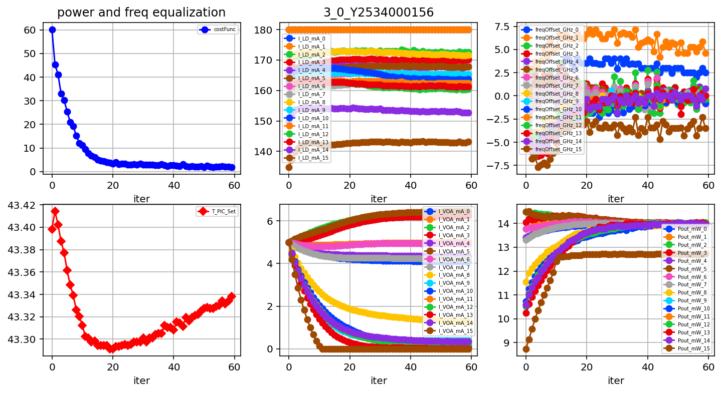
Package Y253400156, Tile 3, ch equalization, Endeavour, Kurtz

Slide 5
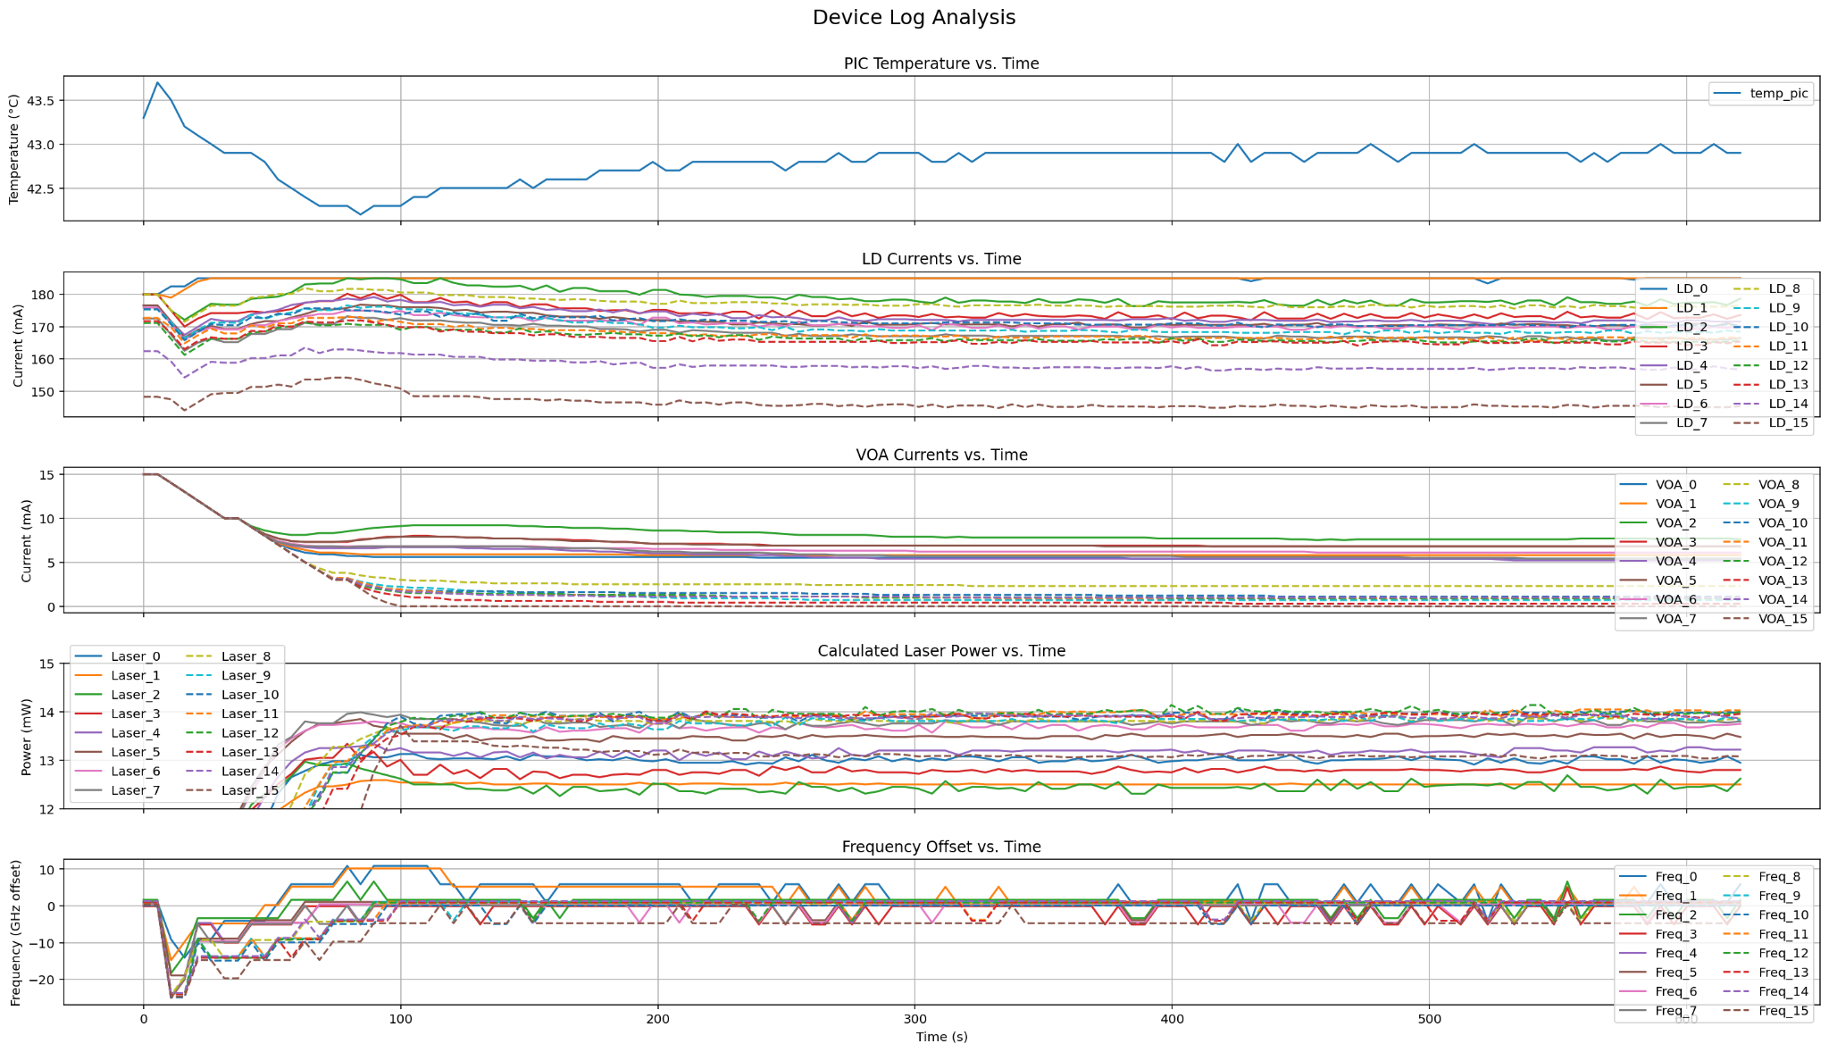
Package Y253400156, Tile 3, ch equalization, Endeavor
Marlow 1.1

Slide 6
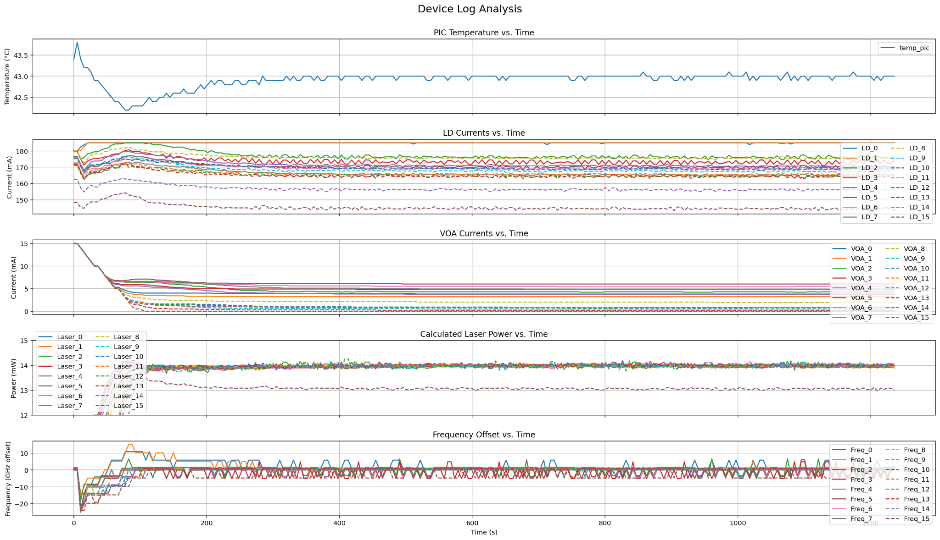
Package Y253400156, Tile 3, ch equalization, Endeavor
Marlow 1.2 pre-release

Slide 7
Kenya spec (6.4 mW)

Slide 8
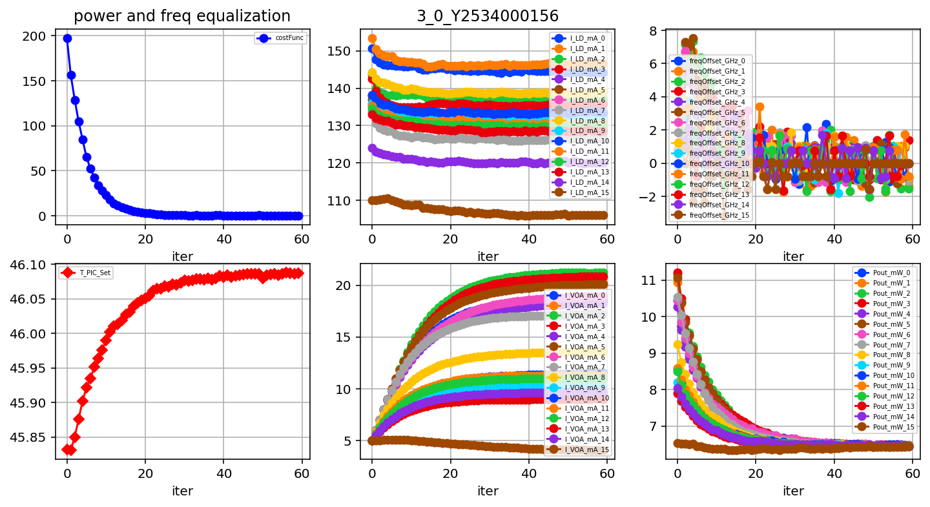
Package Y253400156, Tile 3, ch equalization, Kenya, New procedure

Slide 9
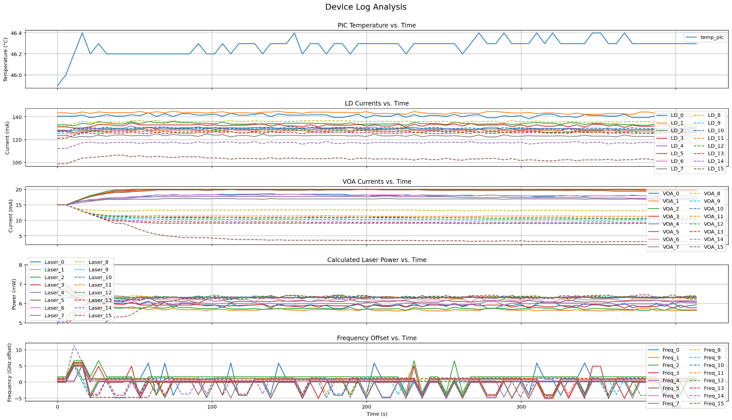
Package Y253400156, Tile 3, ch equalization, Kenya
Marlow 1.1

Slide 10
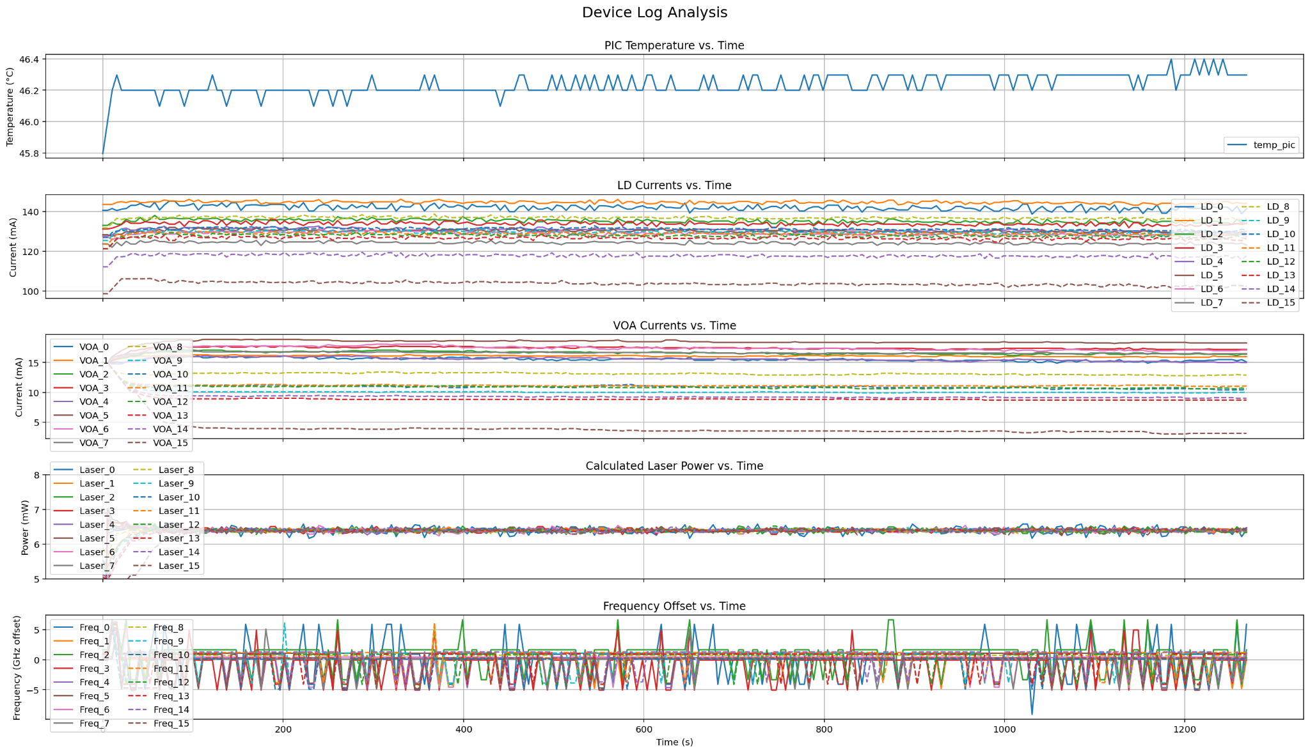
Package Y253400156, Tile 3, ch equalization, Kenya
Marlow 1.2 pre-release

